Slide 1
Doctor AWK
How to find your way around a linux environment
Or: How I learned To Stop Worrying And Love Linux

Slide 2
You all have trial Triton accounts
obotvinnik
ljamal
jdjensen
ilopezmoyado
roneil
amraman
dskola
j6yao
jiz105
kaz007
kuding
mkramer
nmih
e.g.:
jdavistu@triton-login.sdsc.edu

Slide 3
Where the heck am I?
pwd
cd folder
cd ~
cd ..
ls
ls -l
ls -a # show hidden files that start with '.'
ls -ltrh = sort by most recent, show Human readable

Slide 4
Make some files
mkdir
rmdir # does not work if
cp a b # copy a to be
mv # move (to a different folder) or rename (same folder)
warning: rm -rf ./dir # this erases the folder with no warnings!

Slide 5
Edit a file
vi file
hit "i" to edit (enter insert mode)
hit "ESC" to get back to command mode
Some handy commands:
u # Undo!
dd # delete line
:w # save, :q! # quit w/out saving :wq # save and quit
See vi Cheat Sheet on Google Drive

Slide 6
Where is my file / why doesn't it find a command?
locate pattern # This finds file matching *pattern*
sudo updatedb # Updates the 'locate' database
# These two commands give you an error:
ifconfig # Tells you about your internet connections, including IP
which ifconfig # tells you the path to the command 'ifconfig'
# WHY? because ifconfig is not in our path
[jdavistu@triton-43 ~]$ locate ifconfig
/sbin/ifconfig
# Option 1: Include full path in command
[jdavistu@triton-43 ~]$ /sbin/ifconfig
# Option 2: A) Add these lines to ~/.bash_profile:
PATH=$PATH:/sbin/
export path
B) Exit and Login again, or run "source ~/.bash_profile"

Slide 7
Let's try an example
which python #/usr/bin/python
vi ~/.bash_profile
(hit i)
(edit this line:)
PATH=$PATH:$HOME/bin
(to this:)
PATH=/home/jdavistu/epd-7.3-2-rh3-x86_64/bin:$PATH:$HOME/bin
(hit ESC :wq ENTER)
source ~/.bash_profile
which python #/home/jdavistu/epd-7.3-2-rh3-x86_64/bin/python

Slide 8

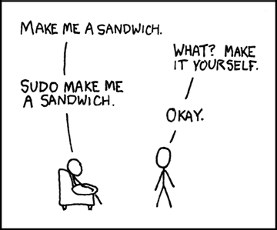
But it won't let me edit/open/run!
chmod 755 file # may need to make it executible
chown jeremy:jeremy file
sudo ... "With great power comes great responsibilitiy"
[jeremy@bigmax bryce]$ touch newfile
touch: cannot touch `newfile': Permission denied
[jeremy@bigmax bryce]$ sudo touch newfile
[sudo] password for jeremy:
[jeremy@bigmax bryce]$
# None of the commands on this slide work on the Triton server
http://xkcd.com/149/

Slide 9
There's no room!
du -h # Check how much hard drive this folde is taking up
du -hs
df -h # Report free disk space
Is it running?
top
ps aux | grep phrase

Slide 10
If you hit some weird button combo by accident, maybe you can fix it ...
Ctrl-c quits things
Ctrl-z puts things in background!!! oops
( fg ('fore-ground') allows you to restore)

Slide 11
Installing stuff
yum list *python*
sudo yum install package
-OR-
apt-get install
Installing from source: good luck!
tar -xzvf foo.tar.gz # unzip (z), extract (x)
sudo ./configure
sudo make
sudo make install

Slide 12
Other basic commands
uname -a # what OS
/sbin/ifconfig # Find IP address
ln -s target link_name # create symbolic link (~shorcut)
wget www.address . # download data
scp/ssh/ftp # connect to other servers

Slide 13
"Advanced" stuff
Now that we know our way around, how do we make use of Linux?

Slide 14
Run in the background / 'parallel'
nohup command &
# This will also let you log out from the client
YOU MIGHT AS WELL ALWAYS USE THIS:
screen # starts up a screen, which is like a new login
# to 'detach': Ctrl-a Ctrl-d
screen -list # list available screens
screen -r # re-attaches screen if only one exists
screen -r foo # re-attaches screen matching *foo*

Slide 15
Shell Scripting: the 'sh' command
You can put multiple commands together in one file:
# For example, create a file 'test.sh' that has these commands:
mkdir foo
mv foo bar
# Then run:
sh test.sh
# There should now be a directory called 'bar'

Slide 16
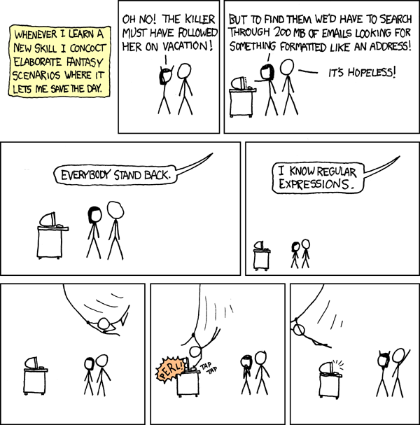
File manipulation
grep pattern file # global regular expression: -n, -A, -B options helpful
wc -l file # number of lines in file
cut -f 3 file # takes the 3rd column
cut -f 2-4 cut -f 3,5
head file
tail -n 40 file # last 40 lines
# how many unique values in column 3 of file?
cut -f 3 file | sort | uniq | wc -l
cat a >> tmp
cat b >> tmp # concatenate files one after another
paste a b > c # puts the columns together (e.g. cbind in R)
https://xkcd.com/208/

Slide 17
AWK: File manipulation like a boss
# general:
awk '/regular expression/ { do stuff: default is to print}'
awk -f script_file -F field_separator 'OFS="\t" BEGIN{a=0} { print $1}'
# examples
awk '/>/' file # prints out headers only, from a FASTA
# add 'Gene Length' to a .bed file
awk '{print $3-$2}' foo.bed > foo.geneLengths
paste foo.bed foo.geneLength > foo2.bed

Slide 18
# Awk example 2: Print protein-coding genes that don't duplicate the same position as the previous one
# file foo.bed:
Chr Pos Name
chr1 1234 NM_123
chr1 3465 NM_1234
chr1 3465 NM_456
chr3 3454 NR_345
chrX 2345 NM_578
# script.awk
BEGIN {chr=""; pos=0;}
/NM/ && NR > 1 {
if(!(chr== $1 && pos ==$2)) {print}
chr=$1;pos=$2 }
awk -f script.awk foo.bed | less

